Slide 1
Object Oriented Programming Languages
Pointers With C++

Slide 2
Pointers
We have seen how variables are seen as memory cells that can be accessed using their identifiers.
This way we did not have to care about the physical location of our data within memory, we simply used its identifier whenever we wanted to refer to our variable

Slide 3
Pointers
The memory of your computer can be imagined as a succession of memory cells, each one of the minimal size that computers manage (one byte).
These single-byte memory cells are numbered in a consecutive way, so as, within any block of memory, every cell has the same number as the previous one plus one.
This way, each cell can be easily located in the memory because it has a unique address and all the memory cells follow a successive pattern.

Slide 4

Reference operator (&)
As soon as we declare a variable, the amount of memory needed is assigned for it at a specific location in memory (its memory address). Fortunately, that is a task automatically performed by the operating system during runtime.
However, in some cases we may be interested in knowing the address where our variable is being stored during runtime in order to operate with relative positions to it.
The address that locates a variable within memory is what we call a reference to that variable.
This reference to a variable can be obtained by preceding the identifier of a variable with an ampersand sign (&), known as reference operator, and which can be literally translated as "address of". For example:

Slide 5
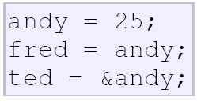
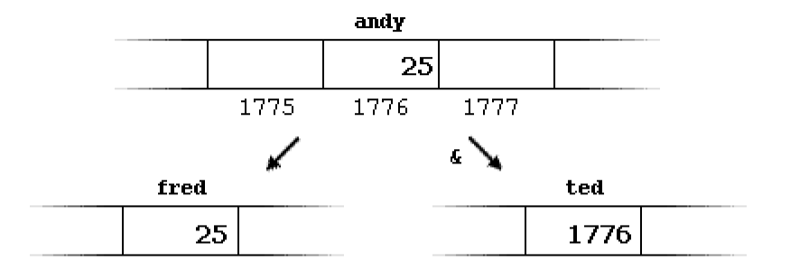
Reference operator (&)
Consider the following code fragment:

Slide 6
Reference operator (&)
The variable that stores the reference to another variable (like ted in the previous example) is what we call a pointer.
Pointers are a very powerful feature of the C++ language that has many uses in advanced programming.

Slide 7
Dereference operator (*)
Pointers are said to "point to" the variable whose reference they store.
Using a pointer we can directly access the value stored in the variable which it points to.
To do this, we simply have to precede the pointer's identifier with an asterisk (*), which acts as dereference operator and that can be literally translated to "value pointed by".

Slide 8
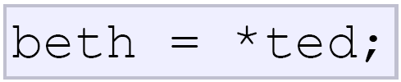
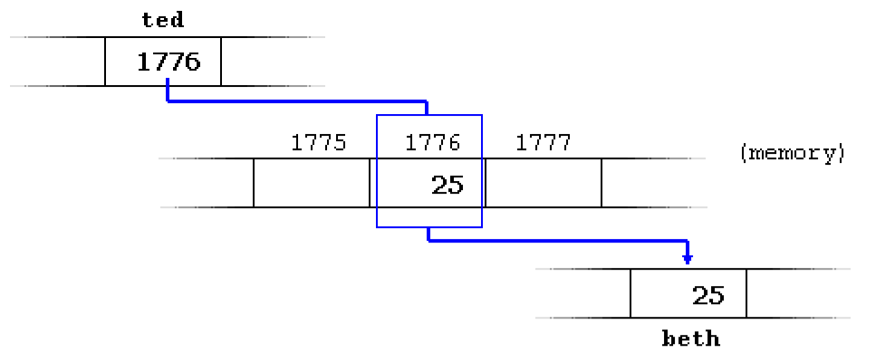
Dereference operator (*)
We could read as: "beth equal to value pointed by ted“
beth would take the value 25, since ted is 1776, and the value pointed by 1776 is 25

Slide 9
Declaring variables of pointer types
Due to the ability of a pointer to directly refer to the value that it points to, it becomes necessary to specify in its declaration which data type a pointer is going to point to.
It is not the same thing to point to a char as to point to an int or a float.
The declaration of pointers follows this format:
Data-type * name;

Slide 10
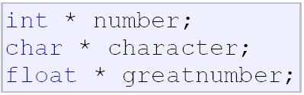
Declaring variables of pointer types
These are three declarations of pointers. Each one is intended to point to a different data type, but in fact all of them are pointers and all of them will occupy the same amount of space in memory (the size in memory of a pointer depends on the platform where the code is going to run).
Nevertheless, the data to which they point to do not occupy the same amount of space nor are of the same type

Slide 11
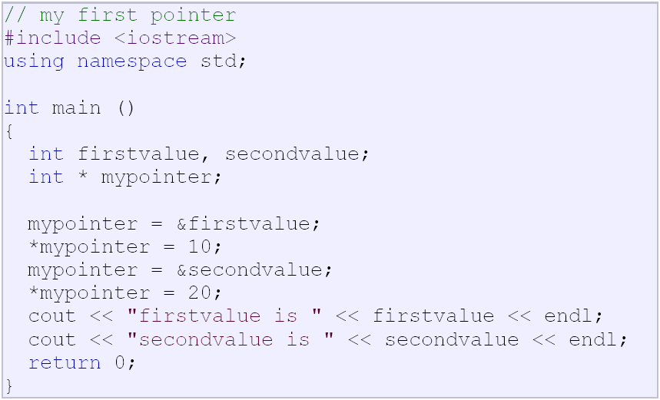
Now have a look at this code:

Slide 12
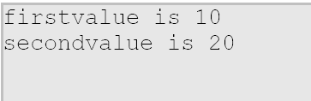
Now have a look at this code: O/P

Slide 13
Example : 2
  #include <iostream>
  using namespace std;
  int main ()
  {
  int firstvalue = 5, secondvalue = 15;
  int * p1, * p2;
  p1 = &firstvalue; // p1 = address of firstvalue
  p2 = &secondvalue; // p2 = address of secondvalue
  *p1 = 10; // value pointed by p1 = 10
  *p2 = *p1; // value pointed by p2 = value pointed by p1
  p1 = p2; // p1 = p2 (value of pointer is copied)
  *p1 = 20; // value pointed by p1 = 20
  cout << "firstvalue is " << firstvalue << endl;
  cout << "secondvalue is " << secondvalue << endl; return 0;
  }

Slide 14
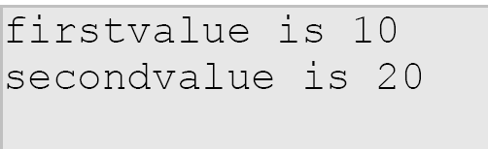
Example : 2 – O/P

Slide 15


Attention…!!!
Are both same ?
p1 would indeed have int* type, but p2 would have type int
simply remembering that you have to put one asterisk per pointer

Slide 16
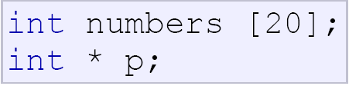

Pointers and arrays
The concept of array is very much bound to the one of pointer. In fact, the identifier of an array is equivalent to the address of its first element
The following assignment operation would be valid:

Slide 17
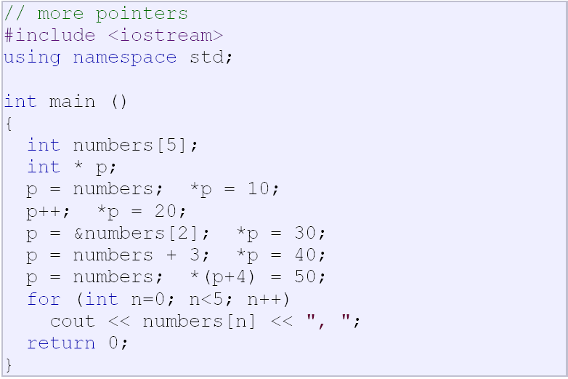
Pointers and arrays

Slide 18


Pointers and arrays – O/P
Consider…
These two expressions are equivalent and valid both if a is a pointer or if a is an array.

Slide 19
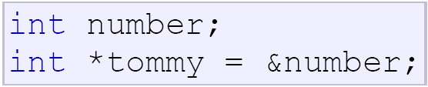
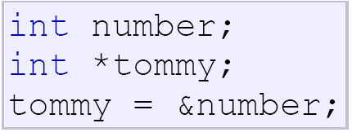
Pointer initialization
Explicitly specify which variable we want them to point to:
The behavior of this code is equivalent to:

Slide 20
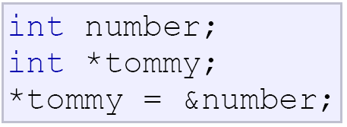
Pointer initialization
When a pointer initialization takes place we are always assigning the reference value to where the pointer points (tommy), never the value being pointed (*tommy).
that is incorrect,

Slide 21

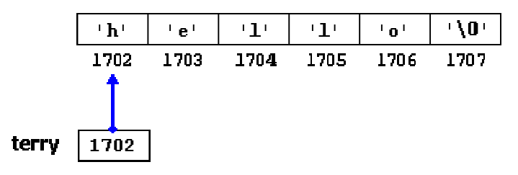
Pointer initialization
As in the case of arrays,
In this case, memory space is reserved to contain "hello" and then a pointer to the first character of this memory block is assigned to terry.
It is important to indicate that terry contains the value 1702, and not 'h' nor "hello", although 1702 indeed is the address of both of these

Slide 22
Pointer arithmetics
Only addition and subtraction operations are allowed to be conducted with them, the others make no sense in the world of pointers
Both addition and subtraction have a different behavior with pointers according to the size of the data type to which they point
Some occupy more or less space than others in the memory. For example, let's assume that in a given compiler for a specific machine, char takes 1 byte, short takes 2 bytes and long takes 4.

Slide 23
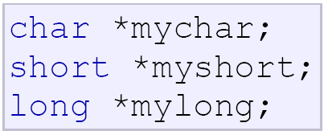
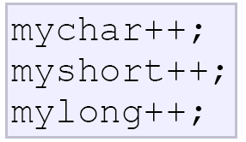
Pointer arithmetics
Suppose that we define three pointers in this compiler:
And that we know that they point to memory locations 1000, 2000 and 3000 respectively
So if we write:

Slide 24
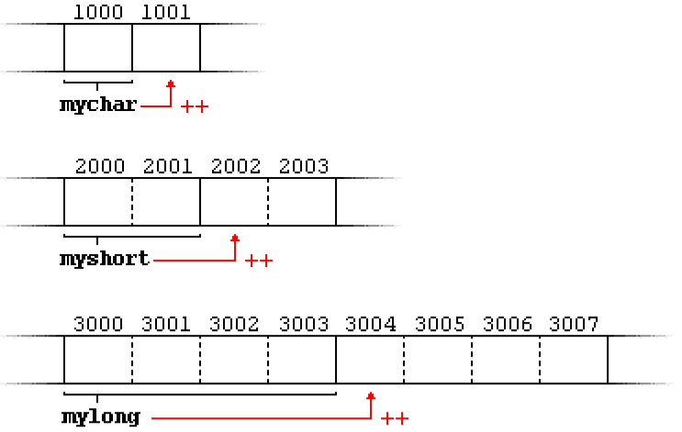
Pointer arithmetics

Slide 25
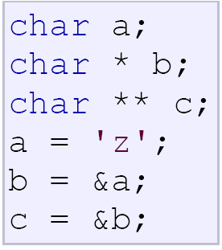
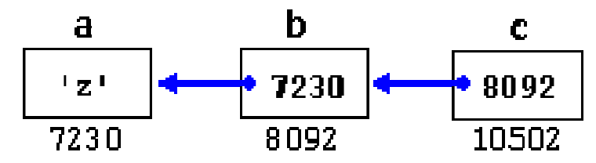
Pointers to pointers
C++ allows the use of pointers that point to pointers, that these, in its turn, point to data (or even to other pointers).
c has type char** and a value of 8092
*c has type char* and a value of 7230
**c has type char and a value of 'z'

Slide 26
Void Pointers
The void type of pointer is a special type of pointer.
In C++, void represents the absence of type, so void pointers are pointers that point to a value that has no type
This allows void pointers to point to any data type, from an integer value or a float to a string of characters.
But in exchange they have a great limitation: the data pointed by them cannot be directly dereferenced.
One of its uses may be to pass generic parameters to a function

Slide 27

Null pointer
A null pointer is a regular pointer of any pointer type which has a special value that indicates that it is not pointing to any valid reference or memory address.
This value is the result of type-casting the integer value zero to any pointer type.

Slide 28
Null pointer
Do not confuse null pointers with void pointers.
A null pointer is a value that any pointer may take to represent that it is pointing to "nowhere", while a void pointer is a special type of pointer that can point to “somewhere” without a specific type.

Slide 29

Dynamic Memory
We need a variable amount of memory that can only be determined during runtime
Operators new and new[ ]
      pointer = new type
      pointer = new type [number_of_elements]
The first expression is used to allocate memory to contain one single element of type type. The second one is used to assign a block (an array) of elements of type, where number_of_elements is an integer value representing the amount.

Slide 30
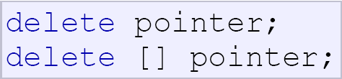
Dynamic Memory
Operators delete and delete[]
Dynamic memory once it is no longer needed it should be freed so that the memory becomes available again for other requests of dynamic memory.
The first expression should be used to delete memory allocated for a single element, and the second one for memory allocated for arrays of elements

Slide 31
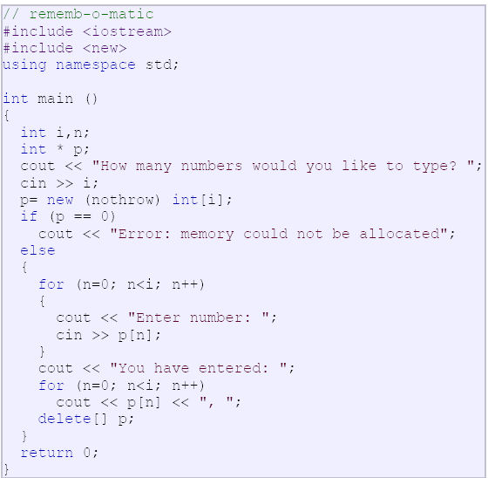
Dynamic Memory

